Slide 1



Noida Institute of Engineering and Technology, Greater Noida
Application Layer Security
Unit: 2
Cyber Security
ANC0301
Mr. Sujeet Singh Bhadouria
Assistant Professor
(CSE)
NIET, Gr. Noida
(B Tech IIIrd Sem)

Slide 2

Faculty Profile
FACULTY PROFILE
Name of Faculty: Sujeet Singh Bhadouria
Designation & Department: Assistant Professor, CSE
Qualification: Ph.D (Pre-Submission) M.Tech
Experience: 10 Years of teaching experience
Area of Interest: Computer Network
Reviewer: IET Communications ISSN 1751-8644 (SCI & SCOPUS INDEX)
Research Publications:
International Journal 09
Paper Presentation 06
International Patent 01 (Granted)
National Patent 04

Slide 3
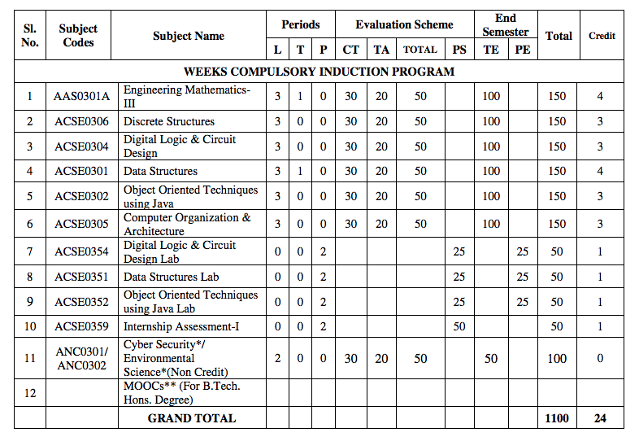
Evaluation Scheme

Slide 4
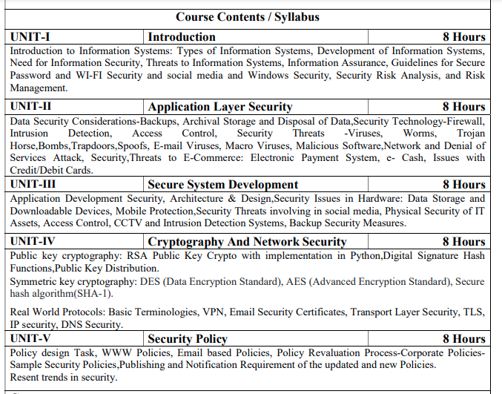
Syllabus

Slide 5
Branch Wise Applications
There are many cyber security real-life examples where financial organizations like banks and social organizations, weather channels etc. have faced cyber-attacks and have lost valuable information and resources. To fix these problems, you'll need comprehensive cyber security awareness.
According to KPMG, the annual compensation for cyber security heads ranges from 2 Cr to 4 Cr annually. The industry also reports a satisfaction level of 68%, making it a mentally and financially satisfying career for most.

Slide 6
Course Objective
Students will learn about :
Security of Information system and Risk factors.
Examine security threats and vulnerability in various scenarios.
Understand concept of cryptography and encryption technique to protect the data from cyber-attack
Provide protection for software and hardware.

Slide 7
Course Outcome
After successful completion of this course student will be able to -
COURSE OUTCOME NO. | COURSE OUTCOMES | Bloom’s Knowledge Level (KL)
CO1 | Analyze the cyber security needs of an organization. | K4
CO2 | Identify and examine software vulnerabilities and security solutions. | K1, K3
CO3 | Comprehend IT Assets security (hardware and Software) and performance indicators. | K2
CO4 | Measure the performance and encoding strategies of security systems. | K3, K5
CO5 | Understand and apply cyber security methods and policies to enhance current scenario security. | K2, K3

Slide 8
Program Outcomes
Engineering knowledge
Problem analysis
Design/development of solutions
Conduct investigations of complex problems
5. Modern tool usage
The engineer and society
Environment and sustainability

Slide 9
Program Outcomes…(cont.)
8. Ethics
Individual and team work
10. Communication
Project management and finance
Life-long learning

Slide 10
CO-PO Mapping
CO-PO Mapping
PO No. CO No. | PO1 | PO2 | PO3 | PO4 | PO5 | PO6 | PO7 | PO8 | PO9 | PO10 | PO11 | PO12
CO1 | 2 | 2 | 1 | 2 | - | - | - | 1 | 2 | 1 | 2 | 2
CO2 | 2 | 2 | 2 | 2 | 2 | 1 | - | 1 | 2 | 1 | 2 | 2
CO3 | 2 | 2 | 1 | 2 | 2 | - | - | 1 | 2 | 1 | 2 | 2
CO4 | 2 | 2 | 1 | 2 | 2 | 1 | - | 1 | 2 | 1 | 2 | 2
CO5 | 2 | 2 | 1 | 2 | 2 | - | - | 1 | 2 | 1 | 2 | 2
*3= High *2= Medium *1=Low

Slide 11
Program Specific Outcomes
Program Specific Outcomes (PSOs) are what the students should be able to do at the time of graduation. The PSOs are program specific. PSOs are written by the department offering the program.
On successful completion of B. Tech. (CSE) Program, the Information and Technology engineering graduates will be able to:
PSO1 : Work as a software developer, database administrator, tester or networking engineer for providing solutions to the real world and industrial problems.
PSO2 : Apply core subjects of information technology related to data structure and algorithm, software engineering, web technology, operating system, database and networking to solve complex IT problems
PSO3 : Practice multi-disciplinary and modern computing techniques by lifelong learning to establish innovative career
PSO4 : Work in a team or individual to manage projects with ethical concern to be a successful employee
or employer in IT industry.

Slide 12
PSO Mapping
Program Specific Outcomes and Course Outcomes Mapping
CO | PSO1 | PSO2 | PSO3 | PSO4
CO1 | 2 | 2 | - | 2
CO2 | 2 | 2 | 1 | 2
CO3 | 2 | 2 | - | 2
CO4 | 2 | 2 | - | 2
CO5 | 2 | 2 | - | 2
*3= High *2= Medium *1=Low

Slide 13

Program Educational Objectives
The Program Educational Objectives (PEOs) of an engineering degree program are the statements that describe the expected achievements of graduates in their career, and what the graduates are expected to perform and achieve during the first few years after graduation.
PEO1: To have an excellent scientific and engineering breadth so as to comprehend, analyze, design and solve real-life problems using state-of-the-art technology.
PEO2: To lead a successful career in industries or to pursue higher studies or to understand entrepreneurial endeavors.
PEO3: To effectively bridge the gap between industry and academics through effective communication skill, professional attitude and a desire to learn.

Slide 14
Result Analysis
Faculty Name | Subject Name | Code | Result
Ms Ruchika Sharma | Cyber Security | ANC0301 | 100%

Slide 15
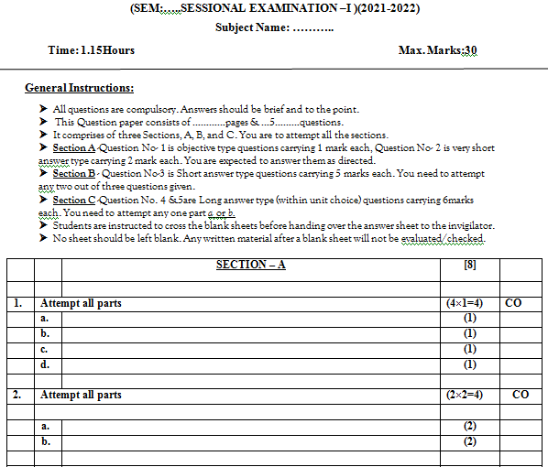
Question Paper Template

Slide 16
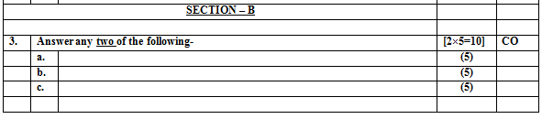
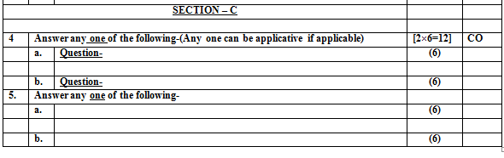
Question Paper Template

Slide 17
Prerequisite/ Recap
Basics recognition in the domain of Computer Science.
Concept of network and operating system.
Commands of programming language.

Slide 18
Brief Introduction about the Subject
Modern life depends on online services, so having a better understanding of cyber security threats is vital.
The course will improve your online safety in the context of the wider world, introducing concepts like malware, trojan virus, network security, cryptography, identity theft, and risk management.
https://www.javatpoint.com/cyber-security-introduction
https://www.edureka.co/blog/what-is-cybersecurity/
http://natoassociation.ca/a-short-introduction-to-cyber-security/

Slide 19
Unit Content
Application Security
Data Security Considerations- Backups, Archival Storage and Disposal of Data
Security Technology(Firewall and VPNs, Intrusion Detection Access Control)
Security Threats
Security Threats to E-Commerce(Electronic Payment System, e- Cash, Credit/Debit Cards)

Slide 20
Unit Objective
Topic | Objective
Data Security Considerations | Develop an understanding of Data Security Considerations-Backups, Archival Storage and Disposal of Data
Security Technology | Examine Security Technology- Firewall and VPNs, Intrusion Detection, Access Control mechanism.
Security Threats | Study the various security threats characteristics Viruses, Worms, Trojan Horse, Bombs, Trapdoors, Spoofs, E-mail Viruses, Macro Viruses, Malicious Software
Security Threats to E-Commerce | Develop an understanding of threats to Electronic Payment System, e- Cash, Credit/Debit Cards.
Public Key Cryptography | Study of basic concept of asymmetric key Cryptography and digital signature

Slide 21
Topic Objective/Topic Outcome
Topic | Objective | CO Mapping
Data Security Considerations | Develop an understanding of Data Security Considerations-Backups, Archival Storage and Disposal of Data | CO2

Slide 22
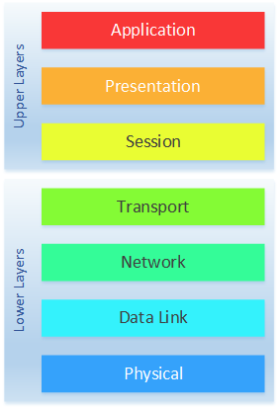
Application Layer

Slide 23
Data Security Considerations(CO2)
Data security consideration involves the protection of data against unauthorized access, modification, destruction, loss, disclosure or transfer whether accidental or intentional.
Some of the important data security consideration are described below:
Backups
Archival storage
Disposal of Data

Slide 24
Data Security Considerations(CO2)
Data backup refers to create additional copies of our data in separate physical or cloud locations from data files in storage.
It is essential for us to keep secure, store, and backup our data on a regular basis. So that if there is loss or changes in data we can recover it using the backup copies.

Slide 25
Data Security Considerations(CO2)
To use the Golden 3-2-1 rule of Backup is very popular.
This rule includes:
Three copies of our data (1 primary and 2 backup copies)
Two different types of storage media.
Onsite (Local storage Hard drives DVDs and CDs) and Offsite (On remote server i.e Cloud)
One off-site backup, i.e., have two physical backups and one in the cloud.

Slide 26
Data Archival Security Considerations
Data archiving is the process of retaining or keeping of data at a secure place for long-term storage. The data might be stored in safe locations so that it can be used whenever it is required.
The archive data is still essential to the organization and may be needed for future reference.
Also, data archives are indexed and have search capabilities so that the files and parts of files can be easily located and retrieved.
The Data archival serve as a way of reducing primary storage consumption of data and its related costs.

Slide 27
Data Archival Security Considerations
The following list of considerations will help us to improve the long-term usefulness of our archives:
Storage medium
The first thing is to what storage medium we use for archives. The archived data will be stored for long periods of time, so we must need to choose the type of media that will be lost as long as our retention policy dictates.
Storage device
This consideration takes into account about the storage device we are using for our archives which will be accessible in a few years. There is no way to predict which types of storage devices will stand the best. So, it is essential to try to pick those devices that have the best chance of being supported over the long term.

Slide 28
Benefits of Data Archival
Reduce cost
Save storage space in the online system
Reduce access complexity
Improve system performance
Efficient identification of preserved data
Use archived data for historical researches

Slide 29
Data Disposal Security Considerations (CO2)
Data destruction or disposal of data is the method of destroying data which is stored on tapes, hard disks and other electronic media so that it is completely unreadable, unusable and inaccessible for unauthorized purposes.
It also ensures that the organization retains records of data for as long as they are needed.
When it is no longer required, appropriately destroys them or disposes of that data.

Slide 30
Data Disposal Security Considerations (CO2)
The managed process of data disposal has some essential benefits-
It avoids the unnecessary storage costs incurred by using office or server space in maintaining records which is no longer needed by the organization.
Finding and retrieving information is easier and quicker because there is less to search.
The disposal of data usually takes place as part of the normal records management process. There are two essential circumstances in which the destruction of data need to be handled as an addition to this process-
The quantity of a legacy record requires attention.
The functions are being transferred to another authority and disposal of data records becomes part of the change process.

Slide 31
Data Disposal Security Considerations (CO2)
Eliminate access
In this consideration, we have to ensure that eliminating access account does not have any rights to re access the disposed of data again.
Destroy the Data
In this consideration, there is not necessary to remove data from storage media will be safe. Even these days reformatting or repartitioning a drive to "erase" the data that it stores is not good enough. Today's many tools available which can help us to delete files more securely. To encrypt the data on the drive before performing any deletion can help us to make data more difficult to recover later.
Destroy the device
In the most cases, storage media need to be physically destroyed to ensure that our sensitive data is not leaked to whoever gets the drives next. In such cases, we should not destroy them itself. To do this, there should be experts who can make probably a lot better at safely and effectively rendering any data on our drives unrecoverable. If we can't trust this to an outsider agency that specializes in the secure destruction of storage devices, we should have a specialized team within our organization who has the same equipment and skills as outside contractors.

Slide 32
Application Security (CO2)
Introduction to Application Security
Security of information and information systems is, undoubtedly, the leading challenge for organizations.
However, they cannot ignore the importance of third-party vendor applications such as Web browsers, and therefore, security measures must be applied to maintain the data and application security.
In order to secure applications, we have various technologies such as firewall, Intrusion detection and Access control systems.
Online purchase of products and services is considered to be one of the most vulnerable uses of the Internet as it involves exchange of finances and identity.

Slide 33
Introduction to Application Security
Attackers, in the last decade, not only targeted the servers and Operating Systems (OSs) but also attacked the Client Applications.
Organizations and individuals use various types of client-side applications that include Browsers, Multimedia Programs, and Document Readers.
The most common attacks on the client-side applications include Phishing and Social Engineering.
Attacker may send malware through e-mail.
Attacker may ask to download a plug-in or a cookie to help you improve your search, but that may turn you into a victim of social engineering attack.

Slide 34
Introduction to Application Security …
Any application interacting with the Web is always under threat.
Most of the OS vendors use patched systems to keep vulnerabilities to the minimum, but even the patched systems are not devoid of attacks.
Zero-day attacks : A zero-day attack is a software-related attack that exploits a weakness that a vendor or developer was unaware of. The name comes from the number of days a software developer has known about the problem. The solution to fixing a zero-day attack is known as a software patch.
Top vendors including Microsoft, Apple computers, Adobe, and Mozilla are the targets of these kinds of attacks.

Slide 35
Introduction to Application Security …
HTTP : Hyper Text Transfer Protocol
HTTPS : Hyper Text Transfer Protocol Secure
HTTPS is HTTP with encryption. The difference between the two protocols is that HTTPS uses TLS (SSL) to encrypt normal HTTP requests and responses.
As a result, HTTPS is far more secure than HTTP. A website that uses HTTP has HTTP:// in its URL, while a website that uses HTTPS has HTTPS://

Slide 36
Daily Quiz
What is Zero day vulnerabilities?
Differentiate Data Backup and Data Archival.
What is application security?
What is data disposal?
Write Golden rule of data backup.

Slide 37
Topic Link
https://youtu.be/2YGUvopGkQc
https://youtu.be/Ofoshc9CblU

Slide 38
Topic Objective/Topic Outcome
Topic | Objective | CO Mapping
Security Technology | Firewall , Intrusion Detection, Access Control mechanism. | CO2

Slide 39
Security Technologies(CO2)
Firewall
A firewall is a network security device that monitors incoming and outgoing network traffic and permits or blocks data packets based on a set of security rules.
Intrusion Detection
Intrusion detection can be defined as the ability to monitor and react to computer misuse.
Access Control System
Access control is a mechanism that defines and controls access rights for individuals who can use specific resources in the OS. Access control systems are the electronic systems that are designed to control through a network and they should have an access to a network.

Slide 40
Firewalls(CO2)
It is a combination of software and hardware.
It maintains private network security by applying security policies at two or more network boundaries.
The Design goals includes -
• All network traffic must pass through the firewall.
• Only authorized traffic will be allowed to pass from a firewall.

Slide 41
Types of Firewalls
Firewalls
Packet filtering
Circuit-level Gateway
Application level Gateway
Source: cyber security, G Padmavathi, swayam

Slide 42

Packet Filtering
It controls network access by analyzing incoming and outgoing packets.
Security Perimeter
Internet
Private
Network
Packet
filtering
router
Source: cyber security, G Padmavathi, swayam

Slide 43
Packet Filtering
Inspects the packets of data that are passed through the network and accepts or rejects the packets on the basis of the default or user-defined rules.
Packet filter is also known as network layer firewall.
Network layer firewalls are of two types-
1. Stateful-
Stateful firewalls maintain the state information of active session.
State contains properties, such as source and destination IP addresses, UDP or TCP ports, and the current stage of the connection’s lifetime.
2. Stateless-
They require less time to filter the packets as they do not maintain the state information of sessions.

Slide 44
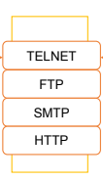

Application level Gateway
It is also known as proxy firewall.
• It filters the inbound traffic to certain specific applications
Application-level gateway
Outside connection
Inside connection
Inside host
Outside host
Source: cyber security, G Padmavathi, swayam

Slide 45
Application level Gateway
Applies security mechanisms to specific applications such as File Transfer Protocol (FTP) and Telnet servers.
Application layer firewalls are based on the application level of the TCP/IP stack. These firewalls intercept all packets that are sent or received from an application.
Application layer firewalls help you in preventing unwanted outside traffic from reaching to protected machines.
These firewalls can restrict or prevent spreading of computer worms and Trojans over a network.

Slide 46
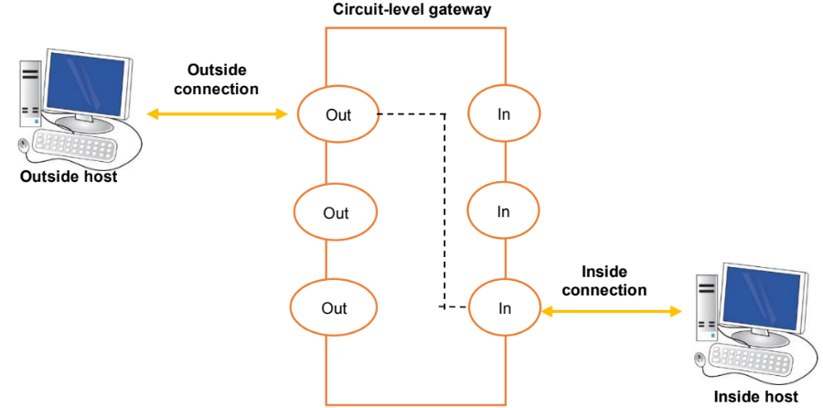
Circuit-Level Gateway
It monitors the TCP data packets handshaking to ensure legitimate session
Source: Swayam

Slide 47
Circuit-Level Gateway
Applies security mechanisms after establishing a TCP or an UDP connection.
The circuit-level gateway firewalls work at the session layer of the OSI model.
They monitor TCP handshaking between the packets to determine whether or not the requested session is legitimate

Slide 48
Virtual Private Network (VPN)(CO2)
VPN is a private communication network, which is the most secure, remote method of connecting a computer to a private network with the help of a public network, such as the Internet.
It creates the virtual tunnel through which the data travels from one computer to the other over the network.
Due to this, an attacker gets the way to use the remote client to relay attacks through the VPN tunnel.

Slide 49
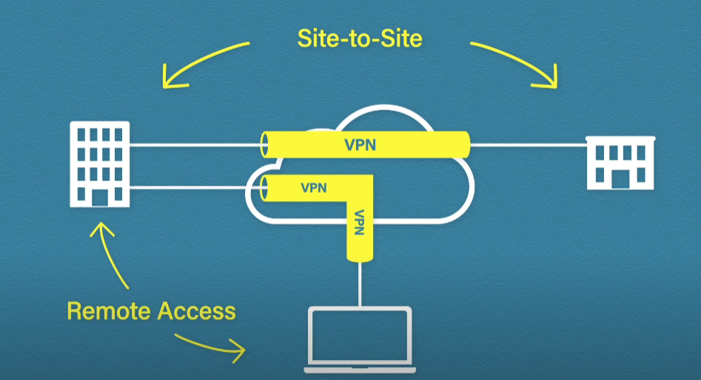
Site to Site and Remote-Access VPNs
Source: CISCO

Slide 50
Intrusion Detection Systems(IDS)(CO2)
IDS monitors network traffic for suspicious activity
Issues alerts in case of illicit activity
Anomaly detection and reporting are two main functions
Administers two jobs namely, forensic analysis and alert generation
Prone to false alarms or false positives

Slide 51
Components of Intrusion Detection
System
An IDS comprises Management console and sensors
It has a database of attack signatures
Sensors detect any malicious activity
It also matches the malicious packet against the database
If found a match, the sensor reports the
malicious activity to the management console

Slide 52
Types of Intrusion Detection Systems
IDS is classified based on its level of operations
IDS
NIDS
HIDS
Source: cyber security, G Padmavathi, swayam

Slide 53
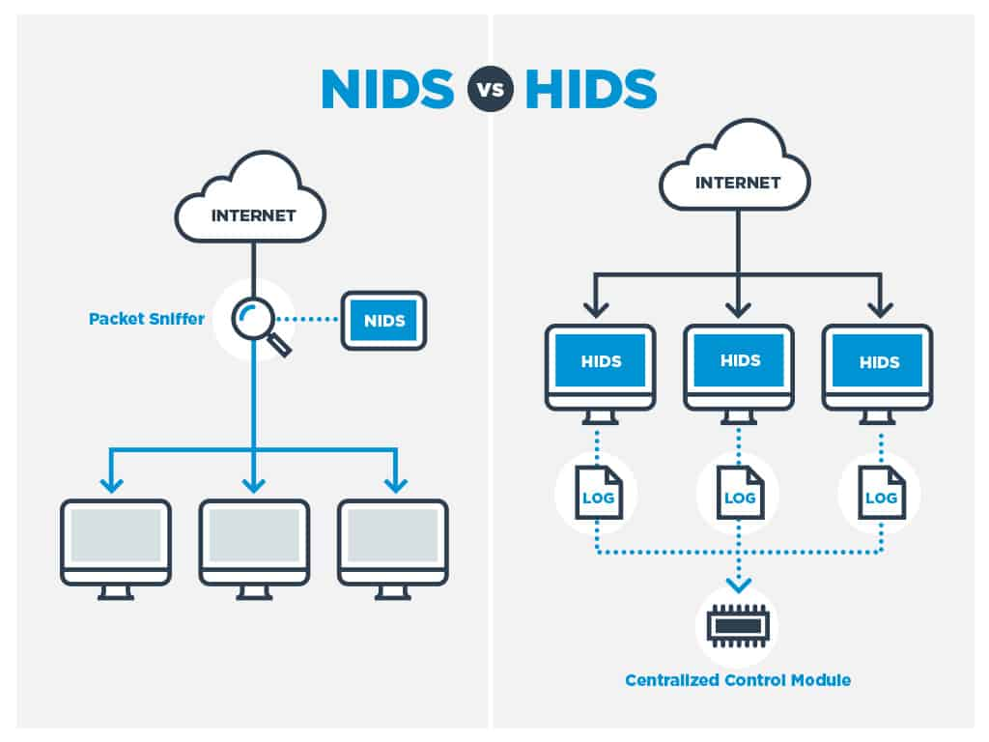
Types of Intrusion Detection Systems
Source: cyber security, G Padmavathi, swayam

Slide 54
Types of Intrusion Detection
System
(NIDS) : A network intrusion detection system is deployed at a strategic point or points within the network, where it can monitor inbound and outbound traffic to and from all the devices on the network.
(HIDS) : A host intrusion detection system runs on all computers or devices in the network with direct access to both the internet and the enterprise's internal network.
A HIDS has an advantage over an NIDS in that it may be able to detect anomalous network packets that originate from inside the organization or malicious traffic that an NIDS has failed to detect.
A HIDS may also be able to identify malicious traffic that originates from the host itself, such as when the host has been infected with malware and is attempting to spread to other systems.

Slide 55

Components of Intrusion Detection
System
Decision Table
Alarm
Detection Engine
Monitors
Malicious
Detection
Response
Configuration
Sensor
Decision Engine
Hosts and Networks
Manages and Reports
Information Recorded
Action
Report
Management Console
Source: cyber security, G Padmavathi, swayam

Slide 56
Recap
Firewalls
-Packet filtering firewalls
-Application level Gateway
-Circuit-level Gateway
Virtual Private Network (VPN)
Intrusion Detection Systems(IDS)
-NIDS
-HIDS
Source: Swayam

Slide 57
Access Control(CO2)
The term ‘access control’ refers to “the control of access to system resources after a user’s account credentials and identity have been authenticated and access to the system has been granted.”
The permission to access a resource is called Authorization.

Slide 58
Access Control
Access control
systems
File permissions
Program permissions
Data rights permissions
User can create, read, edit, or delete file on the server.
User can execute a program on an application server.
User can retrieve or update information in a database.

Slide 59
Access Control
Access Control
Rule-Based Access Control
Mandatory Access Control
Role-Based Access Control
Discretionary Access Control

Slide 60
Mandatory Access Control
Mandatory access control is widely considered the most restrictive access control model in existence.
This type of access control allows only the system's owner to control and manage access based on the settings laid out by the system's programmed parameters.
Such parameters can't be altered or bypassed. The end user doesn't have control over any of the permissions or privileges.
They can only access points that the system owners allow them to access. Because of its high level of restriction, MAC is usually used for facilities or organizations that require maximum security, such as government facilities.

Slide 61
Discretionary Access Control
Discretionary access control is the least restrictive type of access control.
Under this system, individuals are granted complete control over any objects they own and any programs associated with such objects.
The individuals can then determine who has access to their objects by programming security level settings for other users.

Slide 62
Role-Based Access Control
Also known as nondiscretionary access control, role-based access control provides access based on an individual's position in an organization.
In these systems, predefined roles are associated with specific permissions. They allow the administrator to assign an individual only the amount of access required for them to do their job.
Because of its simplicity, this type of access control is one of the most popular forms used in businesses.

Slide 63
Rule-Based Access Control
The last of the four main types of access control for businesses is rule-based access control.
This system assigns or denies access to users based on a set of dynamic rules and limitations defined by the owner or system administrator.
Such rules may limit access based on a number of unique situations, such as the individual's location, the time of day, or the device being used.
The ability to customize rules and permissions makes RBAC an ideal form of access control for businesses that require a dynamic security solution.

Slide 64
Daily Quiz
What is access control?
Differentiate MAC and DAC.
What are the types of Firewall?
What are the types of IDS?
Write types of access control.

Slide 65
Weekly Assignment
Explain Application Security? Explain the steps involved in securing Database?
Explain the working of Virtual Private network?
Explain types of Firewall?
What is the data security consideration? Explain in this reference Data backup security, Data archival security and Data disposal considerations?
w can be Intrusion Detection system is the backbone of Information system? Justify along with its categories?

Slide 66
Topic Link
https://www.youtube.com/watch?v=Zl_BQoJqClM
https://www.youtube.com/watch?v=mY_LtZhd6xU

Slide 67
Topic Objective/Topic Outcome
Topic | Objective | CO Mapping
Security Threats | Study the various security threats characteristics Viruses, Worms, Trojan Horse, Bombs, Trapdoors, Spoofs, E-mail Viruses, Macro Viruses, Malicious Software | CO2

Slide 68
Security Threats(CO2)
Viruses
Worms
Trojan Horse
Bombs
Trapdoors
Spoofs
E-mail viruses
Macro viruses
Malicious Software
Network and Denial of Service Attack
Security

Slide 69
Viruses(CO2)
A virus refers to piece of software that is designed and developed with the purpose of infecting a computer system and performs illicit operations.
A virus infected system can hamper data stored on a hard drive, crash the OS, or get spread on a network.
Some of the ways by which a virus gets transmitted to a system are:
-On using infected media, such as CDs or USB drives
-Through e-mails and accessing social websites as a part
of another program.
Full form of VIRUS : Vital Information Resource Under Seize.

Slide 70
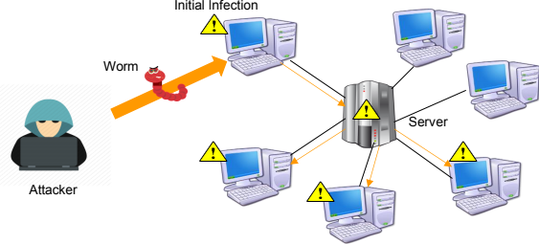
Worms(CO2)
A worm is a type of malware or malicious software that can replicate rapidly and spread across devices within a network.
Source: swayam

Slide 71
Worms
Worms can be defined as threats that are self-sufficient to replicate themselves and do not need any host application to get transmitted.
They are also capable of delivering a virus to a system.
Earlier, the worms used to reside in the RAM of a target computer; however, now a days, they can make use of TCP/IP, e-mail, or Internet services.

Slide 72
Trojan Horses(CO2)
Trojan horses can be defined as programs that are transmitted to a system under disguise of any legitimate application or program, such as an attachment to a program or as part of an installation process.
During installation, either a backdoor is created or the original program gets replaced by a Trojan horse.
Due to difficulty in detection of a Trojan horse, best preventive measure is to backup data after installing new software.

Slide 73
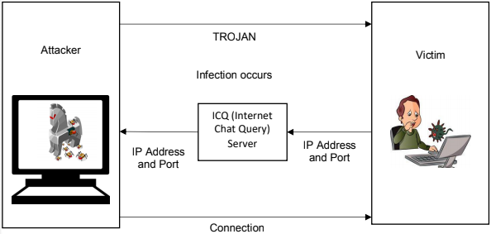
Trojan Horses
Source: Swayam

Slide 74
Logic bombs(CO2)
Logic bombs refer to programs or code snippets that are executed when a predefined event occurs.
These logic bombs display a message to user and occur at time when either the user is accessing the Internet or making use of a word processor application.
The logic bombs do not directly attack; however, they are responsible for informing victim if the criteria for an attack to start have been met.

Slide 75
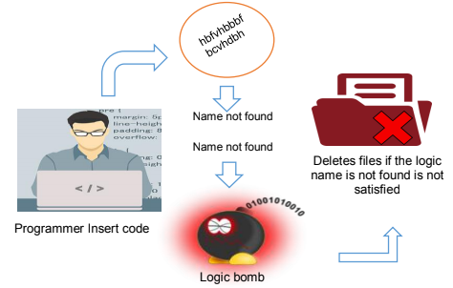
Logic bombs
Source: Swayam

Slide 76
Trapdoors(CO2)
The back door term is referred to as gaining access to a network.
The backdoor attack lets malicious user to enter illicit code at the time of its execution. Moreover, a backdoor attack is primarily an access or a modification attack. However, it requires user ID and password to gain administrative privileges.
Some of the tools that are used to create backdoor attacks are Back Orifice and NetBus.

Slide 77
Spoofing (CO2)
Spoofing means to provide false information about your identity to gain unauthorized access to other’s computer systems.
IP spoofing and DNS spoofing are the most popular spoofing attacks.
The objective of IP spoofing is to make the data look as if it has come from a trusted host, when it did not.
In DNS spoofing, the DNS server is given information about a name server and the server assumes this information as legitimate, when it is not.

Slide 78




IP Spoofing
Source IP: 192.168.1.3
Destination IP: 10.0.0.23
Spoofed source IP address
192.168.1.2
10.0.0.23
Source IP: 10.0.0.23
Destination IP: 192.168.1.3
192.168.1.3
Source: swayam

Slide 79
E-mail Viruses
An email virus is malicious software or a program that attaches itself to an email to infect your computer. Email viruses almost always are linked to malware or phishing attacks.
Source: Swayam

Slide 80

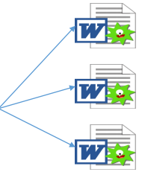

Macro Viruses
The Global Template is used as the basis for the document settings and macros
When an infected document is opened with Word, it will usually copy its macro codes in the Global Template
With the macro virus already resident in the Global Template, it can already produce additional copies of itself to other documents accesses by Word
Source: Swayam

Slide 81
Malicious Software
Malicious code is a new kind of threat in the form of an auto-executable application.
Malicious code can be categorized into the following types:
Code that causes access violations: Refers to the category of malicious code that tries to delete, steal, alter, or execute unauthorized files. It can steal passwords, files, and other confidential data.
Code that enables DoS attacks: Refers to the category of malicious code that prevents the user from using the system. It may destroy the files that are open at the time of the attack.

Slide 82
Network and Denial of Service Attacks(CO2)
A Denial-of-Service (DoS) attack is an attack meant to shut down a machine or network, making it inaccessible to its intended users.
DoS attacks accomplish this by flooding the target with traffic, or sending it information that triggers a crash.

Slide 83
Denial of Services Attack
DoS Attack (Denial of Service Attack)
DDoS Attack (Distributed Denial of Service Attack)
DoS makes the system unresponsive to the actual service requests
It does so by overpowering the system resources
DDoS attack is similar to the DoS attack
Difference is that the attack is launched from a series of host machines

Slide 84
Similarities and differences between Virus, Worms and Trojan horse
Steal information
Self-replicates
Alter data
Delete data
Virus
Passive transmission
Software code
Can mutate
Steal information
Self-replicates
Delete data
Alter data
Worm
Active transmission
Self-contained
Software
Can mutate
Non Self-replicates
Steal information
Open backdoor
Trojan horse
Conscript host for
botnet
Disguised as a
useful program
Keystroke and
webcam logging

Slide 85
Recap
Access control systems
File permissions
Program permissions
Data rights permissions
Security Threats
Viruses
Trojan Horses
Worm
IP Spoofing
Malicious Software

Slide 86
Daily Quiz
What is worm in Network security?
Differentiate trapdoor and Trojan horse.
What is DoS attack?
Write 5 viruses name.
Differentiate between virus and Worm.
What is IP Spoofing?
What is Trapdoor?
what is Ransomware?

Slide 87
Weekly Assignment
Explain Application Security? Explain the steps involved in securing Database?
Explain types of Firewall?
Explain the difference between Virus, Worms, Logic bomb and Trojan Horse?

Slide 88
Weekly Assignment
4. What is the data security consideration? Explain in this reference Data backup security, Data archival security and Data disposal considerations?
5. How can be Intrusion Detection system is the backbone of Information system? Justify along with its categories?
6. Write a short note on
A. Denial of service attack.
B. IP spoofing
C. Electronic data interchange

Slide 89
Topic Links
https://youtu.be/2YGUvopGkQc
https://youtu.be/Ofoshc9CblU
https://www.youtube.com/watch?v=Zl_BQoJqClM
https://www.youtube.com/watch?v=mY_LtZhd6xU
https://www.youtube.com/watch?v=qEbZN9GPQ6A
https://youtu.be/dYQMzyfFrTE
https://www.comparitech.com/net-admin/network-intrusion-detection-tools/

Slide 90
Topic Objective/Topic Outcome
Topic | Objective | CO Mapping
Security Threats to E-Commerce | Develop an understanding of threats to Electronic Payment System, e- Cash, Credit/Debit Cards. | CO2

Slide 91
Threats to E-Commerce (CO2)
E-Commerce refers to the activity of buying and selling things over the internet.
E-commerce can be drawn on many technologies such as mobile commerce, Internet marketing, online transaction processing, electronic funds transfer, supply chain management, electronic data interchange (EDI), inventory management systems, and automated data collection systems.
E-commerce threat is occurring by using the internet for unfair means with the intention of stealing, fraud and security breach
Source: swayam

Slide 92
Threats to E-Commerce
Unauthorized internal users who may access confidential information by using passwords for committing fraud or theft.
Former employees of an organization who have maintained access to the information sources directly by creating alternative password. “back doors” into the computer systems or indirectly through former co- workers.
Weak access point in information infrastructure and security that can expose company information and trade secrets.
Source: swayam

Slide 93
Electronic Payment Systems
E-Commerce or Electronics Commerce sites use electronic payment where electronic payment refers to paperless monetary transactions.
Electronic payment has revolutionized the business processing by reducing paper work, transaction costs, labour cost.
Being user friendly and less time consuming than manual processing, helps business organization to expand its market reach / expansion.
Credit Card
Debit Card
Smart Card
E-Money
Electronic Fund Transfer (EFT)
E- Wallet

Slide 94
Types of EPS
E Cash / E Money:
A system that allows a person to pay for goods or services by transmitting a number from one computer to another.
Like the serial numbers on real currency notes, the E-cash numbers are unique.
This is issued by a bank and represents a specified sum of real money.
It is anonymous and reusable.
E-Wallet:
The E-wallet is another payment scheme that operates like a carrier of e-cash and other information.
The aim is to give shoppers a single, simple, and secure way of carrying currency electronically.
Trust is the basis of the e-wallet as a form of electronic payment.

Slide 95
Types of EPS
Smart Card:
A smart card, is any pocket-sized card with embedded integrated circuits which can process data.
This implies that it can receive input which is processed and delivered as an output.
Credit Card :
It is a Plastic Card having a Magnetic Number and code on it.
It has Some fixed amount to spend.
Customer has to repay the spend amount after sometime.
Debit Card :
Similar to Credit card on coding and encryption.
Purchase limit depends on the available balance in the account.

Slide 96
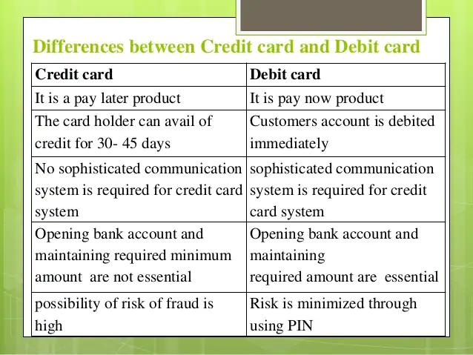
Credit and Debit Card Differences

Slide 97
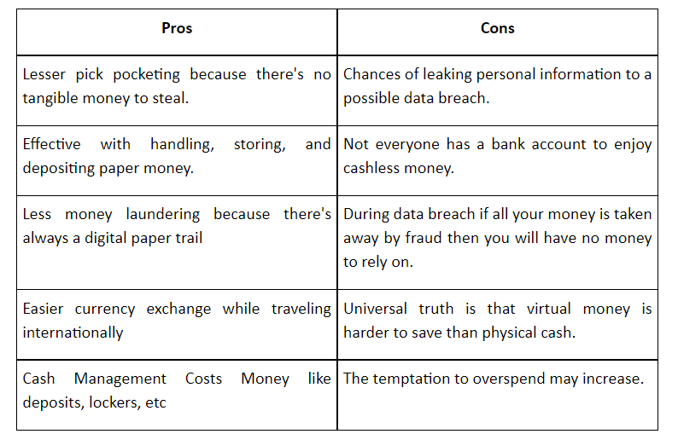
E-cash Pros and Cons

Slide 98
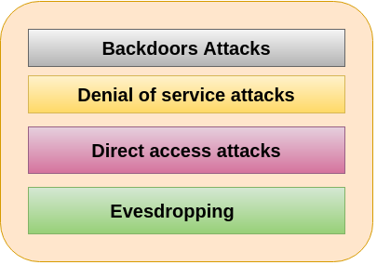
E-cash Threats
Source: javatpoint

Slide 99
Daily Quiz
What is Zero day vulnerabilities?
Differentiate Data Backup and Data Archival.
What are the types of Firewall?
What are the types of IDS?
Write 5 viruses name.
Differentiate virus and Worm.
What is IP Spoofing?
What is Trapdoor?
what is Ransomware?

Slide 100
Weekly Assignment
Explain Application Security? Explain the steps involved in securing Database?
What is digital signature? What are the requirements of digital signature system? List the security services provided by the digital signature.
Explain the working of Virtual Private network?
Explain types of Firewall?
Explain the difference between Virus, Worms, Logic bomb and Trojan Horse?

Slide 101
Weekly Assignment
What is the data security consideration? Explain in this reference Data backup security, Data archival security and Data disposal considerations?
How can be Intrusion Detection system is the backbone of Information system? Justify along with its categories?
Write a short note on
A. Denial of service attack.
B. IP spoofing
C. Electronic data interchange

Slide 102
Topic Links
https://youtu.be/2YGUvopGkQc
https://youtu.be/Ofoshc9CblU
https://www.youtube.com/watch?v=Zl_BQoJqClM
https://www.youtube.com/watch?v=mY_LtZhd6xU
https://www.youtube.com/watch?v=qEbZN9GPQ6A
https://youtu.be/dYQMzyfFrTE
https://www.comparitech.com/net-admin/network-intrusion-detection-tools/

Slide 103
MCQ s
Label the process of setting up of fake access points in high traffic public locations.
a)Unsecured Wi-Fi b)Phishing Attacks
b)Network Spoofing c)Spyware
Recognize the cheapest form of Authentication.
a)Password based Authentication b)Encryption
c)Biometric based Authentication d)Smart cards
Identify the activity that occurs due to malware in Cloud Services.
a)Trojans b)Worms
c)Macro viruses d)Data Exfiltration

Slide 104
MCQ s
Which is the most common risk in social media?
a)Third-party apps b) Spams
c)Privacy settings d)Human error
Point out the security methods applied against man-in-the-middle attack.
a)Biometrics b)Cryptography
c)Digital signature d)Access control list
Data can be disposed by:
a)Handing over the storage devices to anyone
b)Shutting down the system that uses the storage device
c)Thrashing the storage devices into metal scrap
d) None of the above

Slide 105
MCQ s
Firewalls are used to:
a) Provide data backup facilities
b) Prevent hackers from accessing your computer through the Internet by blocking back doors or open ports that connect your computer with the Internet
c) Provide network integration facilities
d) All of the above
Quote the cryptographic type used by Digital Signatures for validating the authenticity and integrity of a message
a) Private key
b) Public key
c) Digital key
d) Digital Certificates

Slide 106
Glossary Questions
Fill the right options:
Management console, attack signatures, Sensors, malicious packet, match
An IDS comprises ___________and sensors
It has a database of ________
_________detect any malicious activity
It also matches the ___________against the database
If found a _____, the sensor reports the malicious activity to the management console

Slide 107
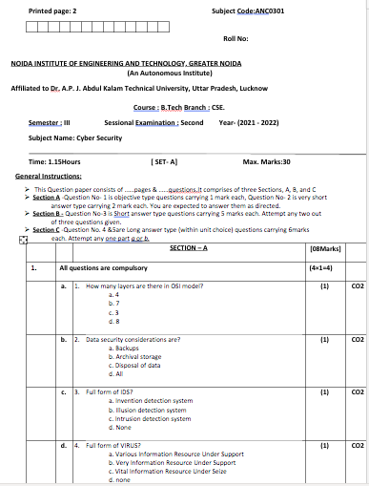
Past Sessional Papers

Slide 108
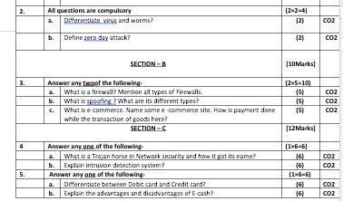
Past Sessional Papers

Slide 109
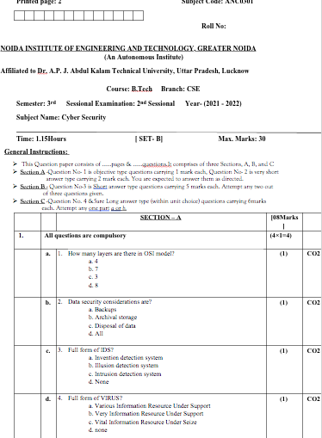
Past Sessional Papers

Slide 110
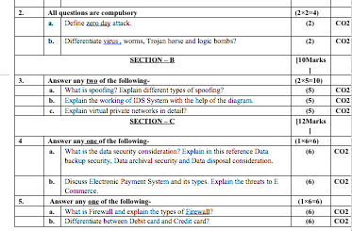
Past Sessional Papers

Slide 111
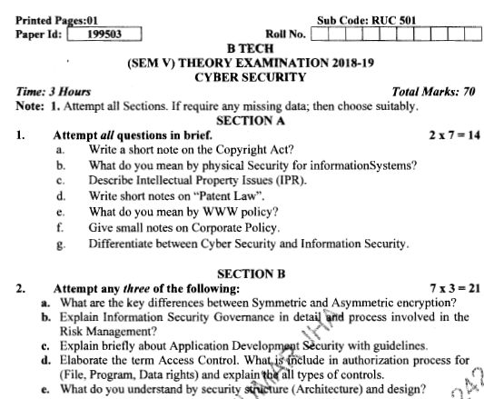
Old Question Papers

Slide 112
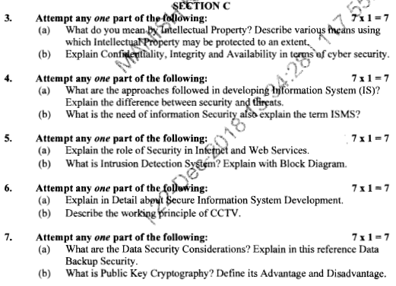
Old Question Papers

Slide 113
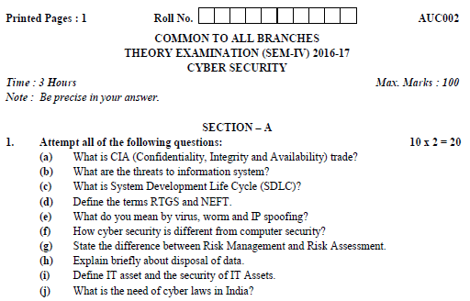
Old Question Papers

Slide 114
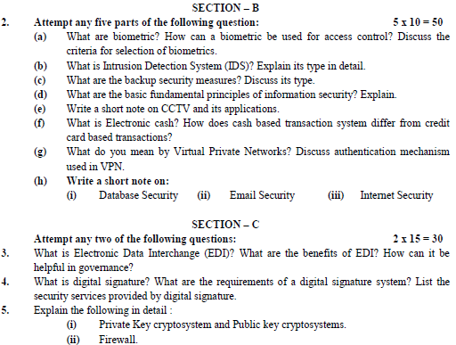
Old Question Papers

Slide 115
Expected Questions for University Exam
Explain the concept of access control mechanism
Explain the components of VPN.
Write characteristics of Stealth Viruses and polymorphic viruses
Explain host based IDS.
Differentiate symmetric and asymmetric key cryptography
What is digital signature?

Slide 116
Recap of Unit
The major topics covered are Firewall and VPNs, Intrusion Detection Access Control, Security Threats, Security Threats to Digital Signature and Public Key Cryptography .
Organizations today have to encounter lot of threats and risks due to the dependency on technology and Internet. Identifying and assessing the vulnerability or risk is an important exercise every organization must undergo at regular periodic intervals due to ever evolving nature of threats and attacks.
This section discussed all the related concepts in detail along with their capabilities and the type of attacks they can mitigate. In future much more intelligent and smart approaches are also possible as the attack strategy is also changing.

Slide 117
References
Charles P. Pfleeger, Shari Lawerance Pfleeger, “Analysing Computer Security ”, Pearson Education India.
V.K. Pachghare, “Cryptography and information Security”, PHI Learning Private Limited, Delhi India.
Dr. Surya Prakash Tripathi, Ritendra Goyal, Praveen kumar Shukla ,”Introduction to Information Security and Cyber Law” Willey Dreamtech Press.(prefer)
https://www.cisco.com/c/dam/en_us/training-events/le21/le34/downloads/689/academy/2008/sessions/BRK-134T_VPNs_Simplified.pdf
https://blog.netwrix.com/2018/05/15/top-10-most-common-types-of-cyber-attacks/
https://www.technologyreview.com/s/609641/six-cyber-threats-to-really-worry-about-
https://www.comparitech.com/net-admin/network-intrusion-detection-tools/
https://onlinecourses.swayam2.ac.in/cec20_cs09

Slide 118
Thank You

